Slide 1


Slide 2



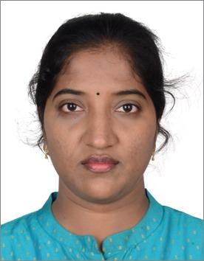



The Snowflake Squad
Adebola Olaoye
Ahmad Tahir
Ajibola Yusuff
Anusha Dommaraju
Harisharan Chandrasekhar
John Okomunda
Kanyinsola Saheed

Slide 3


Business Problem
Complex approval workflows
Limited awareness of Banking services
Manual Processing
Inconvenience & limitations of traditional bank accounts

Slide 4
Snow Fin Corp Outcome
(We make Banking work)
Simple one stop portal for all Banking needs
SNOW
FIN
CORP
Knowledge base to educate customers
Reduced operational costs and complexity
Pioneering account level privileges & benefits
Automated Account creation and Banking services
Improved customer satisfaction and experience

Slide 5
Hierarchy
SNOW FIN CORP
Mountain Lifter
Sky Surfer
Manager
Manager
Tree Hugger
River Runner
Puddle Jumper
Rainbow Rider
Cloud Hopper
Wind Dancer
Exec
Exec
Personal Banking Dept.
Digital Banking Dept.

Slide 6
Staff Roles
Executive
KYC & 1st Level approval for Account Creation
Personal Banker
Manager
BGV & 2nd Level approval for Account Creation
Approve Loans, Safe Lockers, Account Upgrades

Slide 7




Flows
Account
Creation
Account Creation request
KYC & Exec Approval
BGV & Mgr Approval
Update Record
Send Email
Loan request
Balance check
>5000
BGV & Mgr Approval
Update Record
Send Email
Loan
Safe Locker request
Balance check
>3000
BGV & Mgr Approval
Update Record
Send Email
Safe Locker
Upgrade Account request
BGV & Mgr Approval
Update Record
Send Email
Account
Upgrade

Slide 8



Knowledge Bases
Bank Staff – Menu Item
Customer - Portal

Slide 9



Dashboard & Analytics
Dashboards
Account type
Account status
Account Privilege
Loan Status
Safe Locker
Manager
Reports
Access to Reports
Scheduled Reports

Slide 10
Conclusion
Knowledge Bases
Seamless workflows & approvals
Form level customizations
Account creation & Banking Services
Dashboard & Reports
Ease of access & use

Slide 11
Future Enhancements
Department prioritization & SLA compliance
Department wise performance dashboard
Dynamic personal banker assignation
Loan repayment status
Linking insurance with accounts
Personalized portfolio management for digital accounts
Automated expense tracking
Automated Bill payment
Cyber security for account

Slide 12
Challenges & Lesson learnt
Flow logic on how to design & get the required reference & data pills
We approached the logic from a different perspective & made it into simple chunks
We populated the table using Import data & transform maps however we failed to take into account the system counter & created duplicate records
We modified the prefix number
Account number was initially planned to be a choice list
Security issue – We worked around and fetched the value as a string & performed a lookup action
Good team dynamics played a major role in helping us build the App

Slide 13

Thank you
Notes:
Go create your Snow Bank account now!!!

